Slide 1
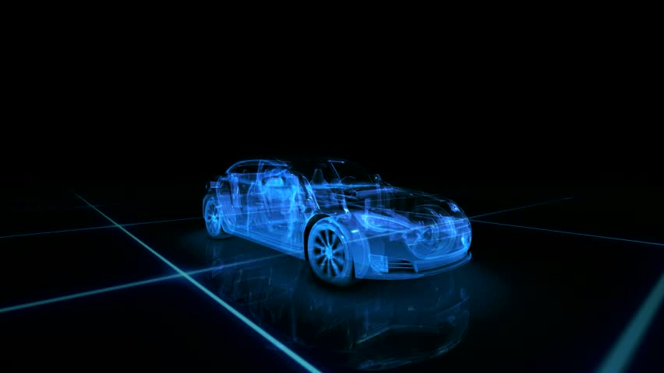
Car Showroom
Final Project Proposal
GROUP 2
THIVEGA PRIYA NADESAN (5999221026)
M.YUSUF HAIDAR K(05111942000022)
MUHAMMAD FADLI AZHAR(5025201157)

Slide 2
Our IDEA
There is a lot of cool stuff on the internet these days, where we can easily buy a lot of things by simply ordering them online.
And for this final project, we will create an interactive 3D model of a cars that we can drag and drop to complete various tasks.
The main purpose of this Online Car Showroom is to make it easier for customers who want to buy cars.
Customers can also see their preferred color on their dream car, and they can also change the color of the materials and windows as well

Slide 3
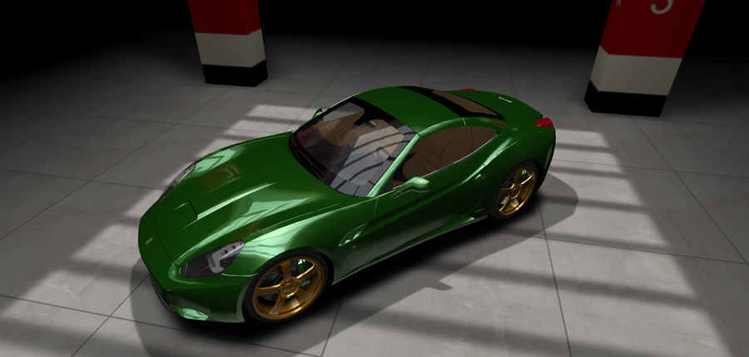
Steps on creating car showroom
First, we'll set things up by defining the lights, camera, and renderer.
Then, to create 3D objects, we'll learn how to define geometries and materials.
Finally, we'll create textures using JavaScript and HTML Canvas.

Slide 4
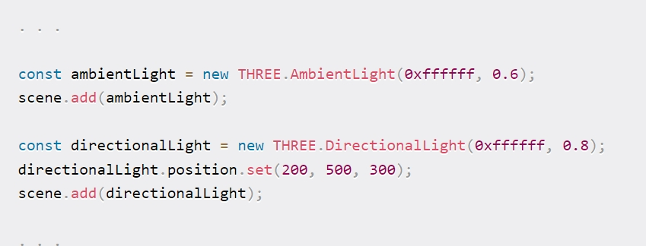
Adding Lights
The scene is a container for all of the 3D objects and lights that will be displayed. first we have to set up the lights, camera, and renderer. To the scene, we'll add two lights: one ambient and one directional. Both are defined by the application of a color and an intensity. The color is defined using a hex value. We will make it white in this case. The intensity is a number between 0 and 1, and we want these values to be around 0.5 because they both shine at the same time.

Slide 5
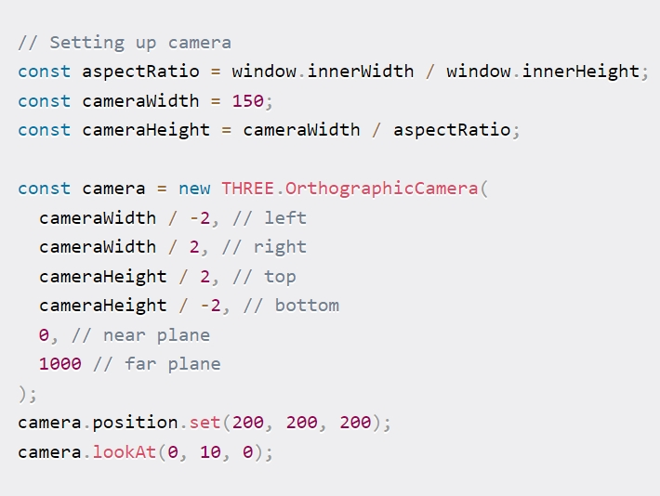
Camera Setup
To set up an orthographic camera, we must first determine the distance between each side of the frustum and the viewpoint. The renderer will determine the size of the rendered image. In this case, these values have an arbitrary unit that we use in 3D space. Later, when defining 3D objects in 3D space, we'll use the same units to define their size and position. After we define a camera, we must position it and turn it in a specific direction.

Slide 6
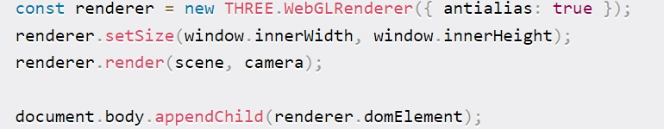
Renderer
We have to configure the canvas size. Because we're determining how it should appear in the browser, we only set the size in pixels. We pass on the window's size if we want to fill the entire browser window. Finally, the final line inserts this rendered image into our HTML document. It adds an HTML Canvas element to the DOM to display the rendered image.

Slide 7
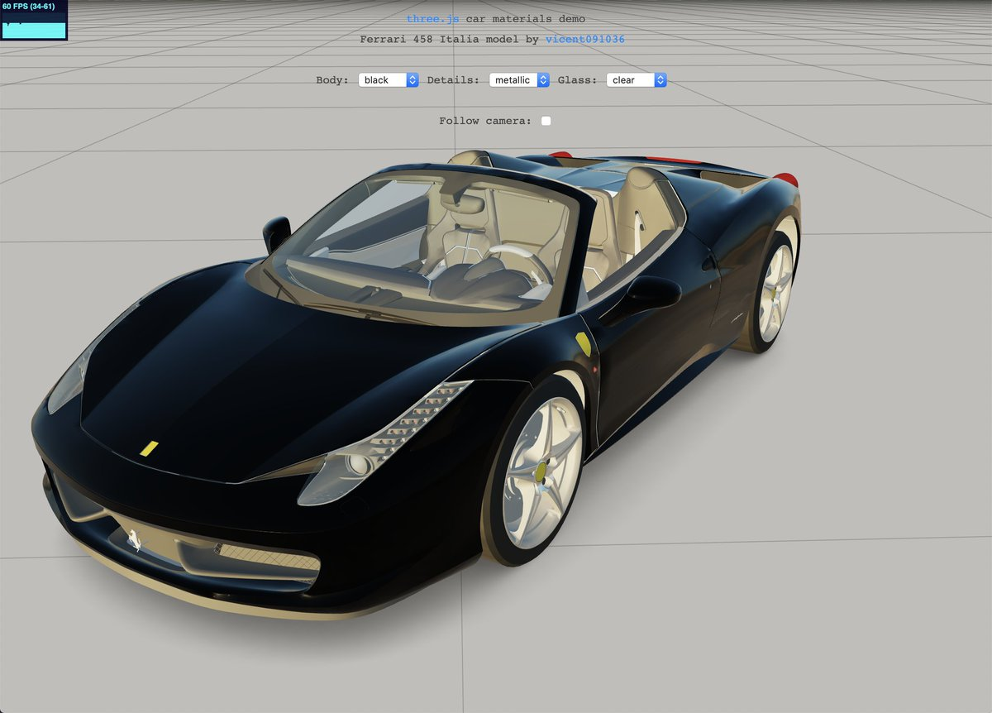
Car showroom elements
Car Type
Finalize
This button is for the final outcome
This button allows us to choose the car type but we will have limited selection of cars
This button allows us to select the car’s mirror type
This button allows us to choose the color of the car that we want.
This button allows us to select the car's details, such as the type, for example, metallic type.

Slide 8
Final outcome (example)
Car Type
Finalize

